Slide 1


Artificial Intelligence
Presented by; Kudaibergenova Ayana
Cs-25

Slide 2
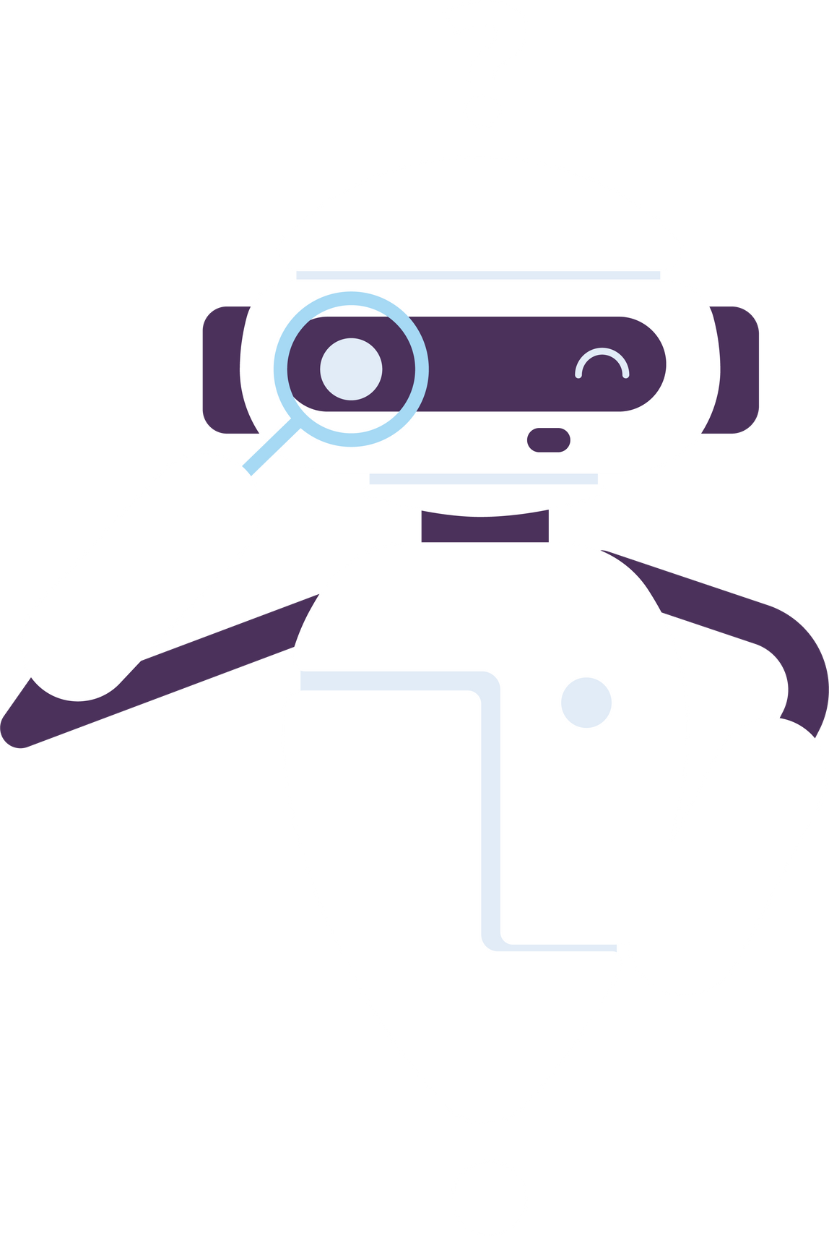
What are they and
Spotify
How do they work?
DeepL
You Tube
Adobe Ai
Google Assistant

Slide 3
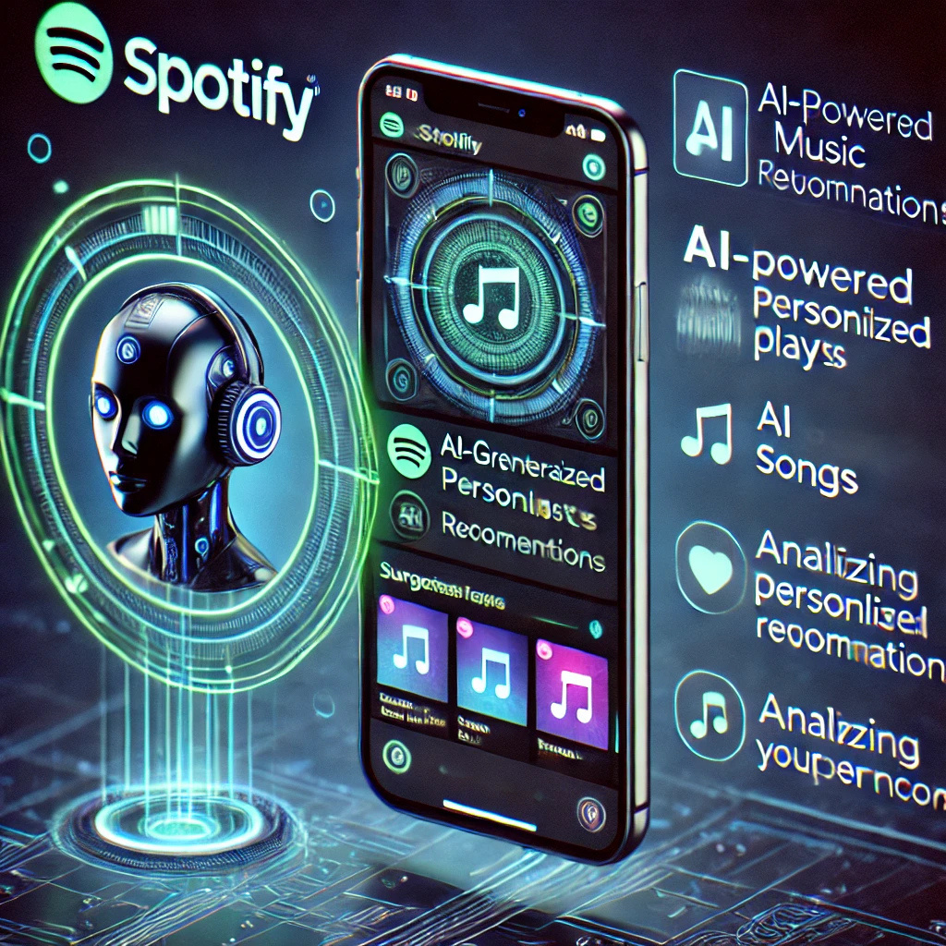
Spotify and AI 🎵
-Economy time – no need to search for music yourself.
-Suggests new songs you might like.
How does AI work in Spotify?
• Machine learning: studies which songs you listen to most often.
• Data analysis: compares your tastes with millions of other users.
• Generative AI: helps find new interesting tracks.

Slide 4

DeepL and AI 🌍
-Translates texts from one language to another.
-Analyzes meaningful phrases, not just replaces words.
-Recognizes context to make translation more stable.
How does AI work in DeepL?
• Deep learning (Neural Networks): analyzes millions of translations.
• Semantic analysis: understands the meaning of the text, not just words.
• Automatically adapts the text style (conversational or formal).

Slide 5

YouTube and AI 📹
Recommends videos that you might like.
Automatically creates subtitles for videos.
Filters unwanted content and protects copyrights.
How does AI work on YouTube
• Recommendation algorithms: analyze your views and likes.
• Speech detection: AI creates subtitles even without text.
• Computer vision: recognizes objects in videos (for example, faces or logos).

Slide 6

Google Assistant and AI 🗣️
-Voice assistant that understands commands and answers questions.
-Can control smart home devices (lights, music, alarm clock).
-Works as a personal assistant (reminders, information search).
How does AI work in Google Assistant?:
• Speech recognition: AI analyzes your voice and understands commands.
• Natural language processing (NLP): understands the meaning, not just words.
• Contextual thinking: remembers past commands for a better answer.versational or formal).

Slide 7

Adobe and Ai🎨
Generates images, texts and videos by text command.
• Automatically edits photos (remove objects, improve quality).
• Creates subtitles and helps with video editing.
.
How does AI work in Adobe
• Adobe Sensei: analyzes and enhances images.
• Firefly: creates content based on text description.
• Computer vision: recognizes objects and faces for precise editing.

Slide 8

Thank you
for attention 🤍

